Slide 1

Collection Development and Use of Library Resources in the University Libraries of Kolkata
RAC
1st SIX MONTHLY PROGRESS REPORT
Submitted for partial fulfilment for the degree of
DOCTOR OF PHILOSOPHY
by
BIPLAB KUMAR CHANDRA
(ENROLMENT No. 20231790)
Under the guidance of
Dr. Mohammad Yusuf (Supervisor)
Associate Professor
Library and Information Science
Mangalayatan University, Aligarh (U.P.), India
&
Dr. Partha Sarathi Das (Co-Supervisor)
Library & Information Officer
National Library , Kolkata
Department of Library and Information Science
Faculty of Humanities
Mangalayatan University, Aligarh, Uttar Pradesh

Slide 2
Chapter 1 Introduction
1. Introduction
1.2 Background of the study
1.3 Collection Development & Use of Library Resources
1.3.1 Definition (Collection Development )
1.3.2 Definition (Use of Library Resources )
1.3.3 Definition (Library Resources)
1.8 Selection of problem
1.9 Objectives of the study
1.10 Scope of the study
1.11 Need of the study

Slide 3
1.9 Objectives of the study
To identify the various types of information resources in the select university libraries of Kolkata.
To know collection management policies of the libraires.
To highlight areas of utilization of information recourses of the libraries by the users.
To point out information resources need of the users of the library.
To asses satisfaction of the users of the libraries.
To know the problem of the libraries in the development of information resources.
To suggest measures for improvement in the development of information resources and their utilization .

Slide 4
REVVEIW OF LIETRATURE
38 literature reviews have been prepared
Research articles 28
Ph.D. Theses 6
Books 4
-------------------------------
Total 38

Slide 5
Haque, Md. Armanul et al. (2023). Discussed about digital media becoming more significant in the subject of information research administration in libraries in the twenty-first century. New difficulties arising were mentioned in this work. This research paper has made an effort to pinpoint them and provide a solution
Joel, A. P., & Ibrahim, F. L. (2021) Highlighted on their paper that, apart from books, information is available from various sources in reading and research work. In that case, institutional repositories are a very useful medium in terms of data storage and services.
Amarasekara, K. M. R. K. & Marasinghe, M. M. I. K. (2020): In this article, 'The main aim of any library is to provide the right information to the right person at the right time in order to full fill the information needs of the users.' - The matter was presented very nicely. The library's information resources and its management policy were of particular importance in influencing library user satisfaction. In order to provide an acceptable, improved library service, the information management in the library need to be given special attention by the authorities.

Slide 6
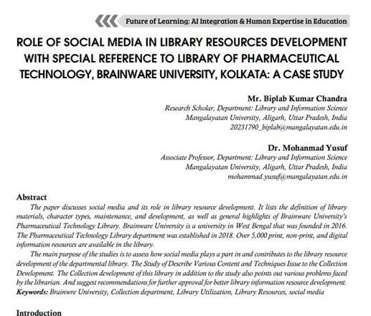
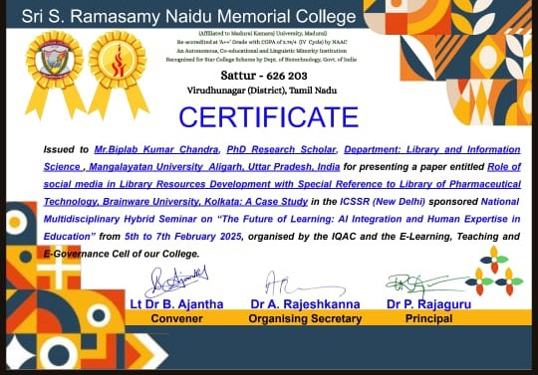
Publication
Attend one National Seminar & publish
National Seminar on “The Future AI integration and human expertise in education ”

Slide 7
WORK WILL BE DONE IN NEXT SIX MONTHS
More reviews will add in the 2nd RAC
Chapter 3 Profile of the University libraries of Kolkata shall be prepared
Formulation of Questionnaires
One more article shall be written for the conference

Slide 8


